Slide 1

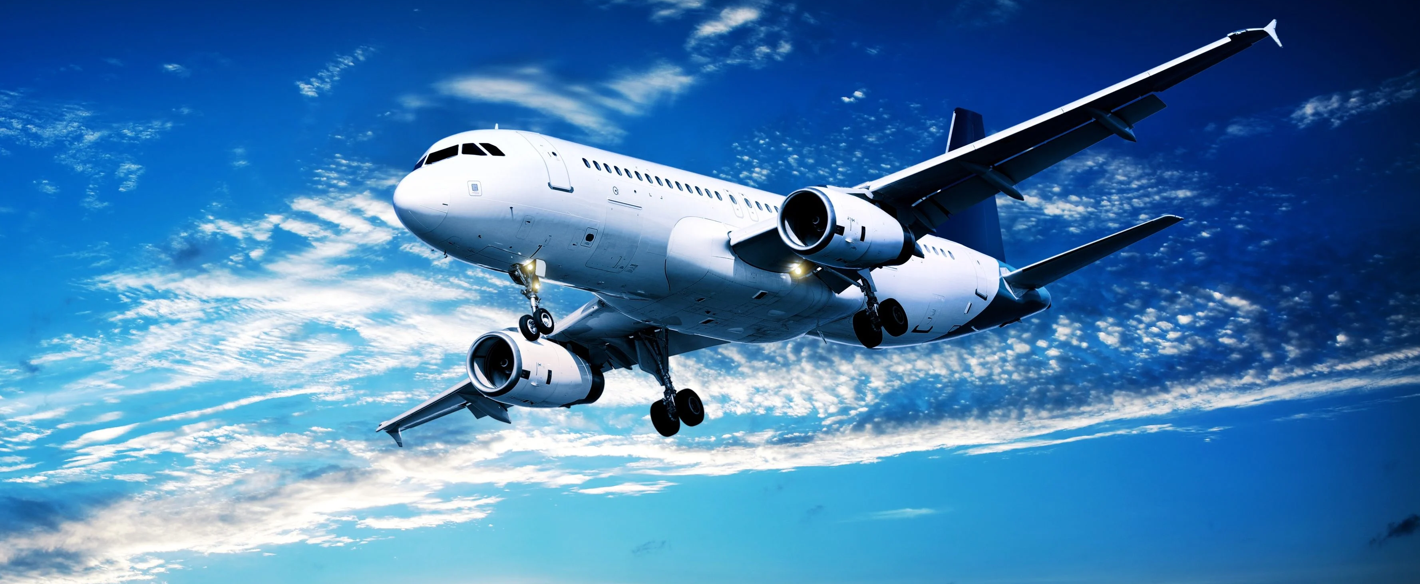
Domain: Aviation Project Name: Flight Delay Analysis

Slide 2
TEAM MEMBERS GROUP -6
Kalpraj Anand
Pooja Rani Nayak
Ritik Gowardhan
Prince Dadhich
Sai Kumar
Pravin Shende

Slide 3
TOOLS USED
Excel
SQL
Tableau
Power BI

Slide 4



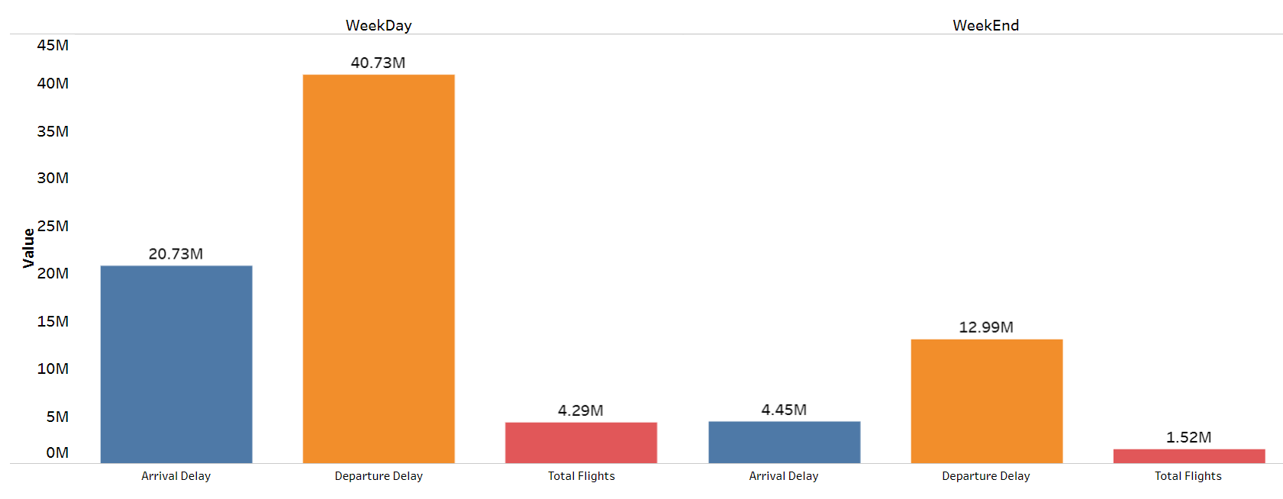

KP1: Weekday Vs Weekend total flights statistics
In the image we can see that the total number of flights in the Weekday is 4.29M & Weekend is 1.52M
Total departure delay in the weekday is seen to be as 40.73M and weekend is 12.99M
Total arrival delay in the weekday is seen to be as 20.73M and weekend is 4.45M .

Slide 5
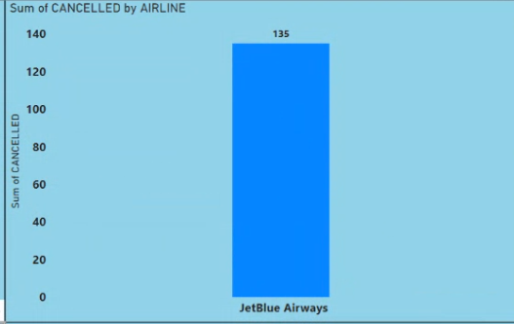
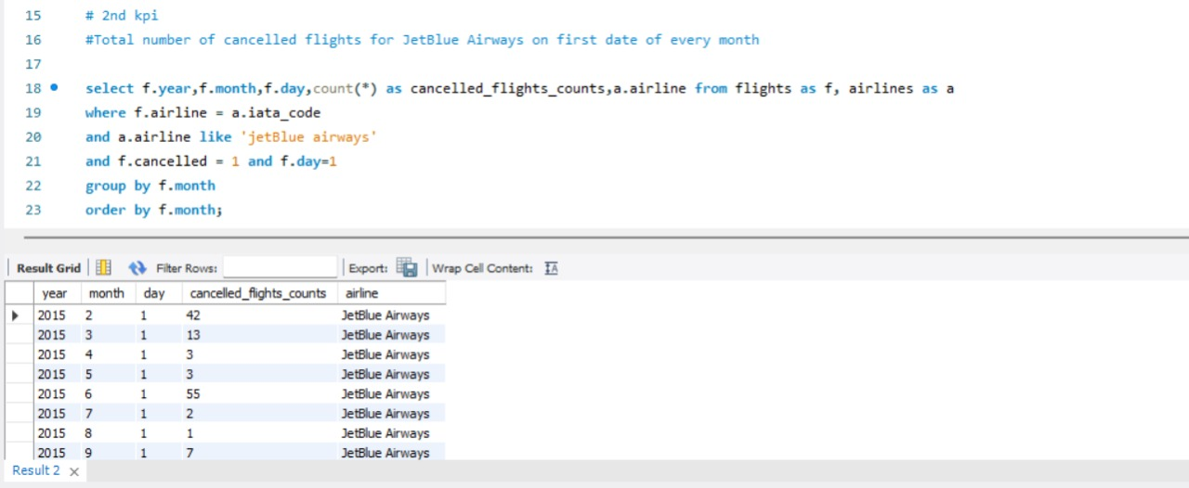
KP2: Total number of cancelled flights for JetBlue Airways on first date of every month
We can see that 4,276 is the total number of flights that is cancelled by Jet Blue Airways
1
Southwest Airlines Co is leading with highest cancelled flights with the number 16,043
2
Atlantic Southeast Airline holds the 2nd highest position in the flight cancellation with the number 15,231
3

Slide 6
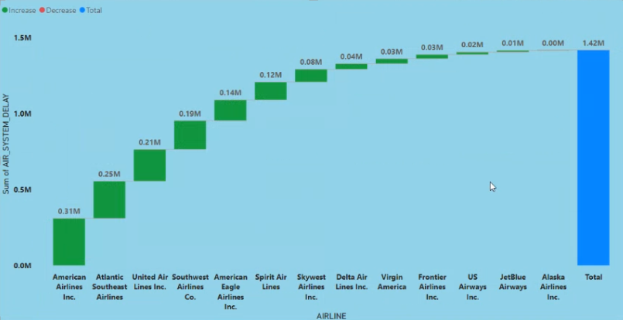
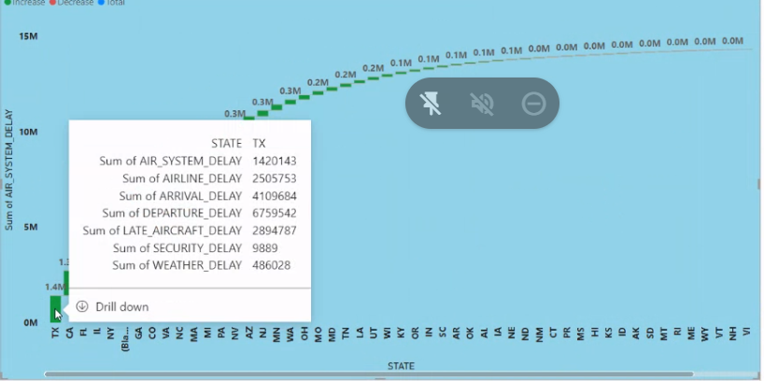
KP3: Week wise, State wise and City wise statistics of delay of flights with airline details
The below figure shows us that 1.42 M is the total delay of all flights through out the state.
The minimum flight delay is of 0.0M by the Alaska Airline and the maximum being 0.31M by American Airline
Texas is the state which has the maximum delay. Among all the delays the departure delay is the most.

Slide 7
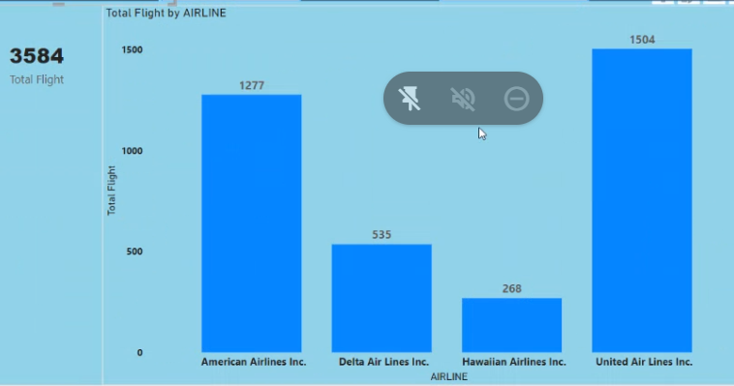
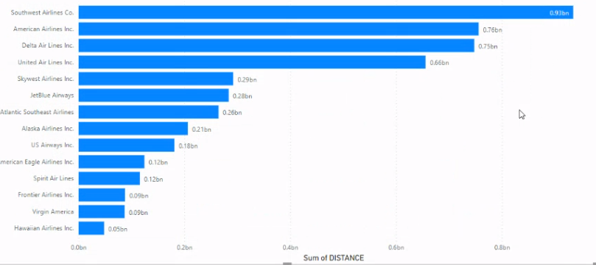
KP4: Number of airlines with No departure/arrival delay with distance covered between 2500 and 3000
934670301 is the highest distance which is covered by the Southwest Airline
American Airline, Delta Airline, Hawaiian Airline, United Airline with no delay
3584 is the total no flight with no departure & arrival delay.

Slide 8
CONCLUSION
Total cancelled flight in weekday is more than the weekend.
01
Chicago is seen to be the busiest airport among all the listed airports.
02
Total diverted flights is 3409 which is by Southwest Airlines
03
Southwest Airlines holds the highest number (0.32M) in the total flights category.
04

Slide 9


